Slide 1
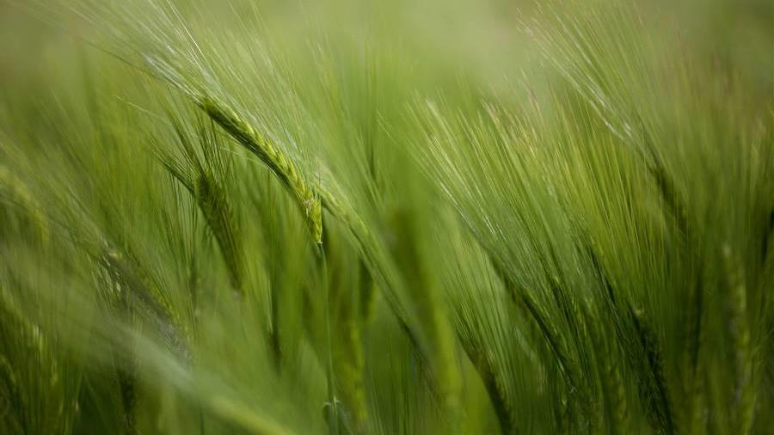
Case study analysis
Coral Baas​​

Slide 2
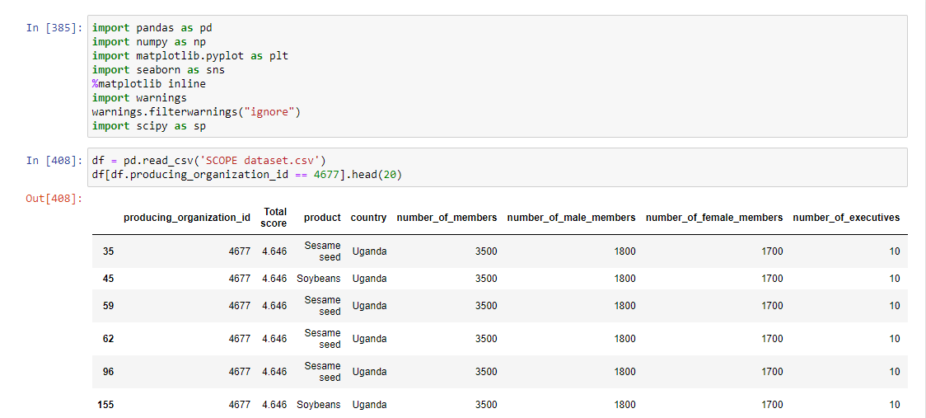

1. Identify top 3 male and female-led performance
Read the file in Python (jupyter notebook) with pandas.
Overview of the data base (4704 rows x 12 columns).
Duplicate rows (id 4677 has 96 rows)
More than one product per id
Each product was evaluated (sub-dimensions SCOPEinsight)

Slide 3
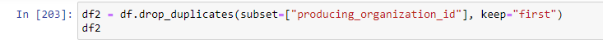
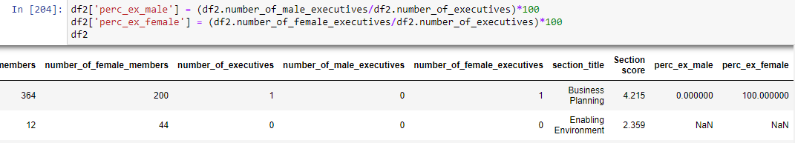
coding
1 drop duplicates
2 Create two columns

Slide 4
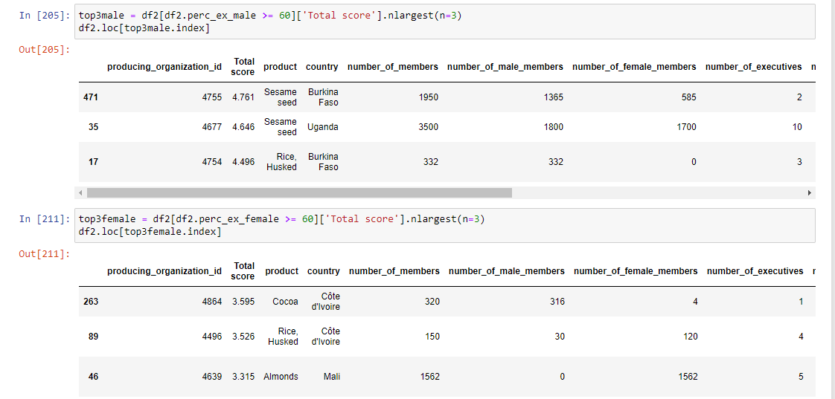

3 create two data frames

Slide 5
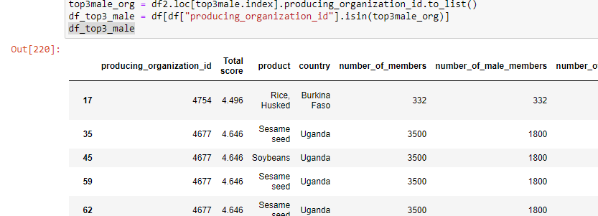
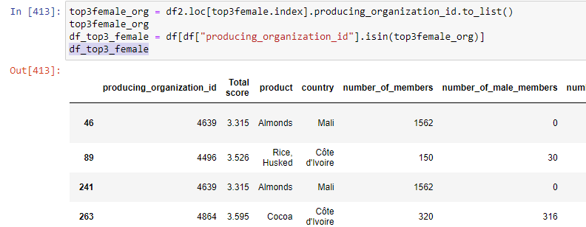
4 retrieve values of the column products - two new DF

Slide 6
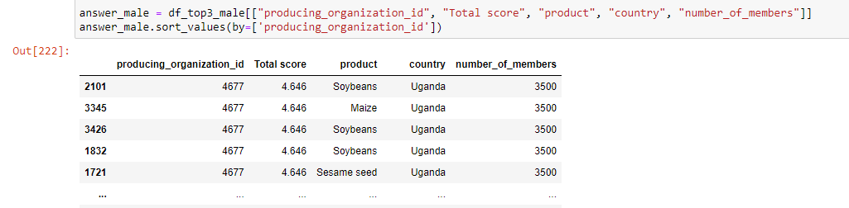
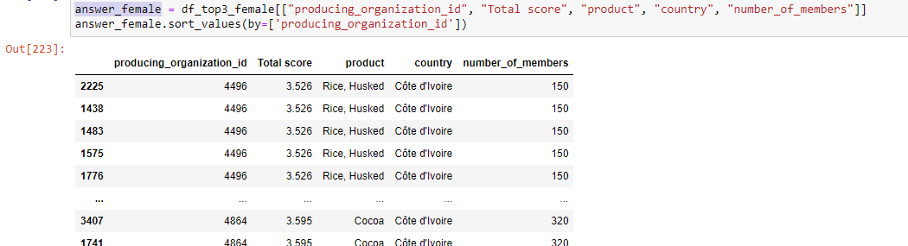
First result

Slide 7
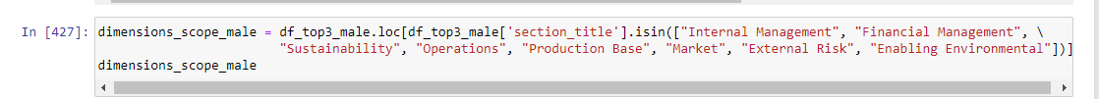
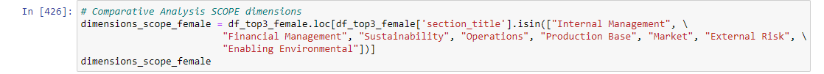
2. Comparative analysis based on scopeinsight dimensions
Recover the duplicates (df original)
Previous result convert in lists
Create two new data frames filtering the 8 dimensions SCOPEinsight
Visualize (sns.barplot)

Slide 8
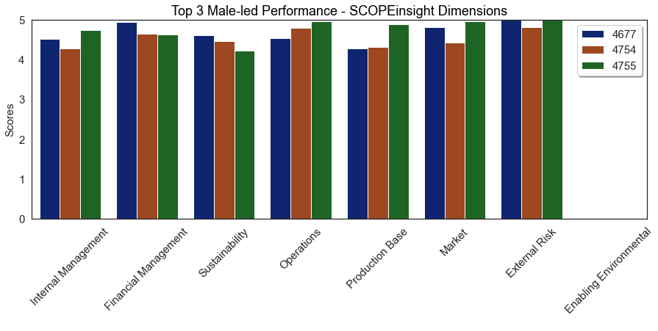
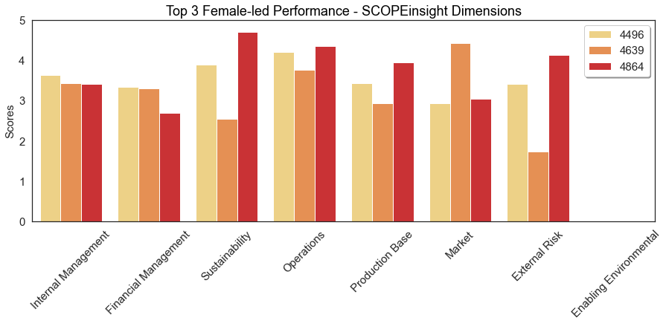

Slide 9
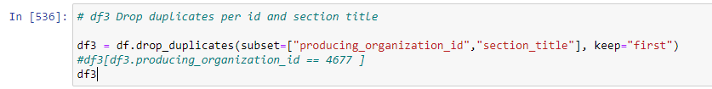
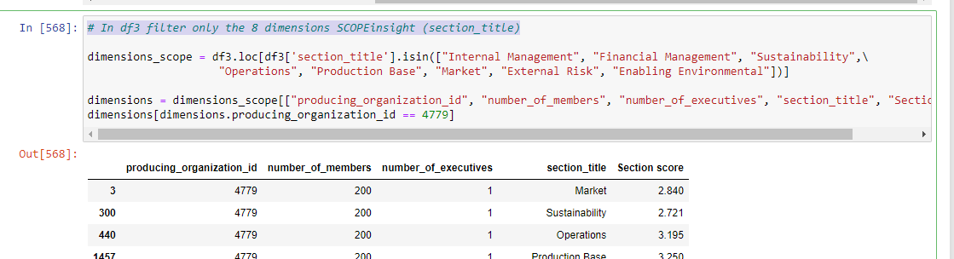
3. Significant correlation #Executives and #members - scopeinsight dimensions
Drop duplicates per id and section title
Filtering in df3 the SCOPEinsight’s 8 dimensions (section_title)

Slide 10
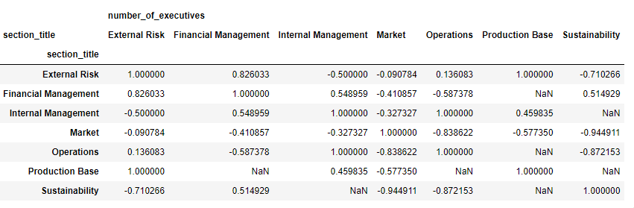
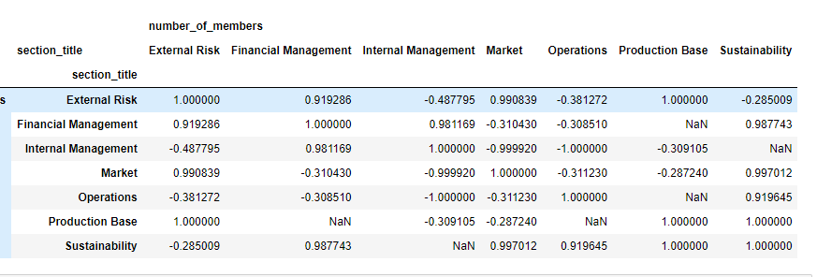
Pivot table
Number of Executives and Section Score
Number of Members and Section Score

Slide 11
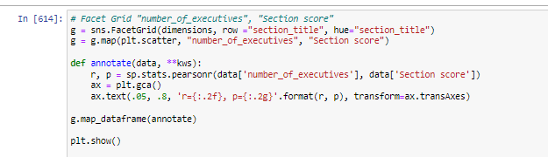
Facet Grid
Number of Executives and Section Score
Number of Members and Section Score

Slide 12
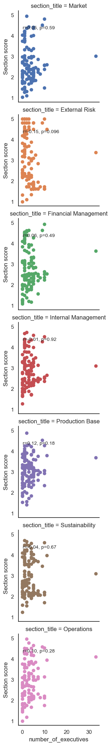

Slide 13
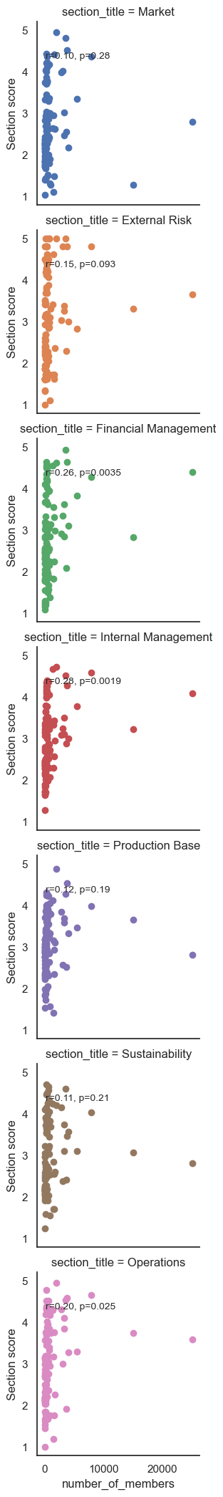

Slide 14
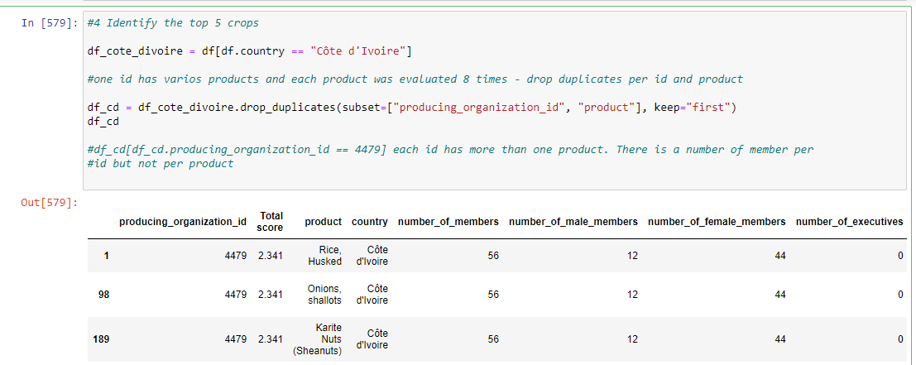
4. Identify the top 5 crops according to the total number of members in Cote d’ivoire - Total Score
Filtering in the original df country Cote d’Ivoire
Dropping duplicates (id, product)
Each id has more than one product. The number of members is per id but not per product.

Slide 15
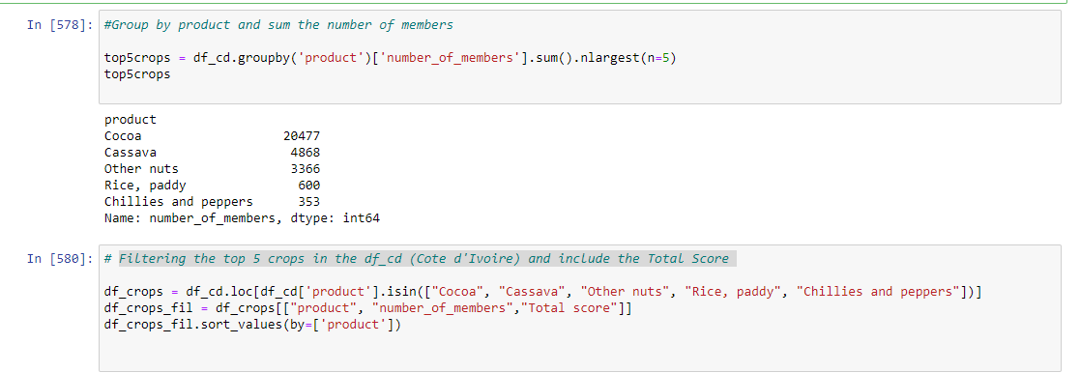
Group by product and sum the number of members
Filtering the top 5 crops in the df_cd (Cote d'Ivoire) and include the Total Score
# Visualize 5 Top Crops Vs. Total Score - Cote d'Ivoire

Slide 16
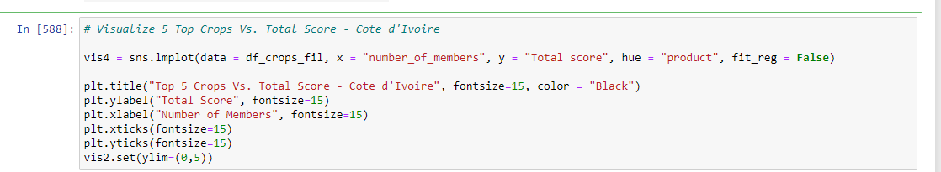
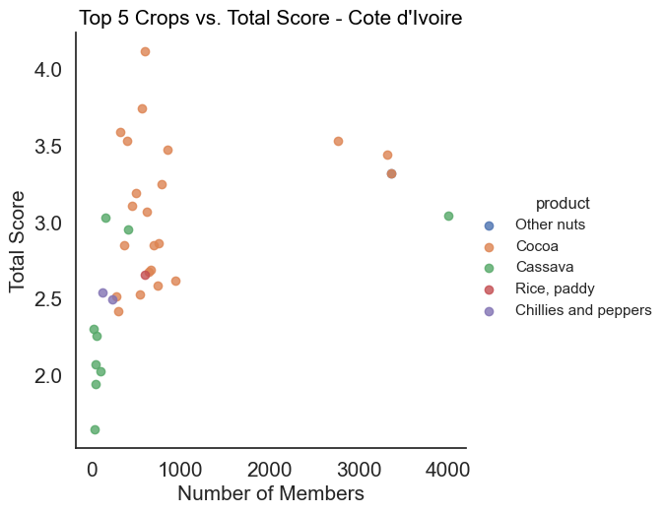
Cocoa has more members and good performance
Cassava has a lot members but low score
Cocoa is a money crop (export)
Cassava is for a local consumption
Other crops have less members and their score is low

